Slide 1
Descriptive Statistics
Dr. Pradeep Bilurkar
Notes:
This template can be used as a starter file for presenting training materials in a group setting.
Sections
Right-click on a slide to add sections. Sections can help to organize your slides or facilitate collaboration between multiple authors.
Notes
Use the Notes section for delivery notes or to provide additional details for the audience. View these notes in Presentation View during your presentation.
Keep in mind the font size (important for accessibility, visibility, videotaping, and online production)
Coordinated colors
Pay particular attention to the graphs, charts, and text boxes.
Consider that attendees will print in black and white or grayscale. Run a test print to make sure your colors work when printed in pure black and white and grayscale.
Graphics, tables, and graphs
Keep it simple: If possible, use consistent, non-distracting styles and colors.
Label all graphs and tables.

Slide 2
Learning Objectives
Basic probability concepts
Conditional probability
To use Bayes’ Theorem to revise probabilities

Slide 3

Statistics is the 'Science of Uncertainty",'
Noel Cressie and Christopher K. Wikle,
Statistics for Spatio-Temporal Data, Wiley, 2011, p. 4

Slide 4
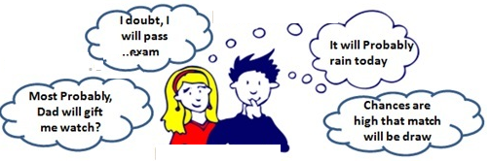
Statistics
Statistics, in a nutshell, is a discipline that studies the best ways of dealing with randomness, or more precisely and broadly, variation. As human beings, we tend to love information, but we hate uncertainty -- especially when we need to make decisions. Information and uncertainty, however, are actually two sides of the same coin. Statistician Xiao-Li Meng
Statistical techniques can't eliminate uncertainty, but can help us gain some knowledge despite it. They can help us see patterns through it, and help us quantify the certainty/uncertainty that the patterns are real and not just chance artifacts of our data or of our perception .

Slide 5
Definitions
Probability: the chance that an uncertain event will occur (always between 0 and 1)
Event: Each possible type of occurrence or outcome
Simple Event: an event that can be described by a single characteristic
Sample Space: the collection of all possible events

Slide 6
Types of Probability
There are three approaches to assessing the probability of an uncertain event:
1. a priori classical probability: the probability of an event is based on prior knowledge of the process involved.
2. empirical classical probability: the probability of an event is based on observed data.
3. subjective probability: the probability of an event is determined by an individual, based on that person’s past experience, personal opinion, and/or analysis of a particular situation.

Slide 7
Calculating Probability
1. a priori classical probability
2. empirical classical probability
These equations assume all outcomes are equally likely.

Slide 8
Example of a priori classical probability
Find the probability of selecting a face card (Jack, Queen, or King) from a standard deck of 52 cards.

Slide 9
Example of empirical classical probability
Find the probability of selecting a male taking statistics from the population described in the following table:
 | Taking Stats | Not Taking Stats | Total
Male | 84 | 145 | 229
Female | 76 | 134 | 210
Total | 160 | 279 | 439

Slide 10
Examples of Sample Space
The Sample Space is the collection of all possible events
ex. All 6 faces of a die:
ex. All 52 cards in a deck of cards
ex. All possible outcomes when having a child: Boy or Girl

Slide 11
Events in Sample Space
Simple event
An outcome from a sample space with one characteristic
ex. A red card from a deck of cards
Complement of an event A (denoted A/)
All outcomes that are not part of event A
ex. All cards that are not diamonds
Joint event
Involves two or more characteristics simultaneously
ex. An ace that is also red from a deck of cards

Slide 12
Visualizing Events in Sample Space
Contingency Tables:
Tree Diagrams:
 | Ace | Not Ace | Total
Black | 2 | 24 | 26
Red | 2 | 24 | 26
Total | 4 | 48 | 52
2
24
2
24
Ace
Black Card
Full Deck
of 52 Cards
Not an Ace
Ace
Sample Space
Red Card
Not an Ace

Slide 13
Definitions Simple vs. Joint Probability
Simple (Marginal) Probability refers to the probability of a simple event.
ex. P(King)
Joint Probability refers to the probability of an occurrence of two or more events.
ex. P(King and Spade)

Slide 14
Definitions Mutually Exclusive Events
Mutually exclusive events are events that cannot occur together (simultaneously).
example:
A = queen of diamonds; B = queen of clubs
Events A and B are mutually exclusive if only one card is selected
example:
B = having a boy; G = having a girl
Events B and G are mutually exclusive if only one child is born

Slide 15
Definitions Collectively Exhaustive Events
Collectively exhaustive events
One of the events must occur
The set of events covers the entire sample space
example:
A = aces; B = black cards; C = diamonds; D = hearts
Events A, B, C and D are collectively exhaustive (but not mutually exclusive – a selected ace may also be a heart)
Events B, C and D are collectively exhaustive and also mutually exclusive

Slide 16
Computing Joint and Marginal Probabilities
The probability of a joint event, A and B:
Computing a marginal (or simple) probability:
Where B₁, B₂, …, B_{k} are k mutually exclusive and collectively exhaustive events

Slide 17
Example: Joint Probability
P(Red and Ace)
 | Ace | Not Ace | Total
Black | 2 | 24 | 26
Red | 2 | 24 | 26
Total | 4 | 48 | 52

Slide 18
Example: Marginal (Simple) Probability
P(Ace)
 | Ace | Not Ace | Total
Black | 2 | 24 | 26
Red | 2 | 24 | 26
Total | 4 | 48 | 52

Slide 19
Joint Probability Using a Contingency Table
Event
Event
B₁
B₂
Total
A₁
P(A₁ and B₁)
P(A₁ and B₂)
P(A₁)
A₂
P(A₂ and B₁)
P(A₂ and B₂)
P(A₂)
Total
P(B₁)
P(B₂)
1
Joint Probabilities
Marginal (Simple) Probabilities

Slide 20
Probability Summary So Far
Probability is the numerical measure of the likelihood that an event will occur.
The probability of any event must be between 0 and 1, inclusively
0 ≤ P(A) ≤ 1 for any event A.
The sum of the probabilities of all mutually exclusive and collectively exhaustive events is 1.
P(A) + P(B) + P(C) = 1
A, B, and C are mutually exclusive and collectively exhaustive
1
Certain
.5
0
Impossible

Slide 21
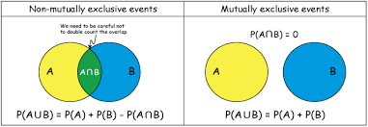
General Addition Rule
General Addition Rule:
P(A or B) = P(A) + P(B) - P(A and B)
If A and B are mutually exclusive, then
P(A and B) = 0, so the rule can be simplified:
P(A or B) = P(A) + P(B)
for mutually exclusive events A and B

Slide 22
General Addition Rule Example
Find the probability of selecting a male or a statistics student from the population described in the following table:
 | Taking Stats | Not Taking Stats | Total
Male | 84 | 145 | 229
Female | 76 | 134 | 210
Total | 160 | 279 | 439
P(Male or Stat) = P(M) + P(S) – P(M AND S)
= 229/439 + 160/439 – 84/439 = 305/439

Slide 23
Conditional Probability
A conditional probability is the probability of one event, given that another event has occurred:
The conditional probability of A given that B has occurred
The conditional probability of B given that A has occurred
Where P(A and B) = joint probability of A and B
P(A) = marginal probability of A
P(B) = marginal probability of B

Slide 24
Computing Conditional Probability
Of the cars on a used car lot, 70% have air conditioning (AC) and 40% have a CD player (CD). 20% of the cars have both.
What is the probability that a car has a CD player, given that it has AC ?
We want to find P(CD | AC).

Slide 25
Computing Conditional Probability
Of the cars on a used car lot, 70% have air conditioning (AC) and 40% have a CD player (CD). 20% of the cars have both.
What is the probability that a car has a CD player, given that it has AC ?
We want to find P(CD | AC).
 | CD | No CD | Total
AC | 0.2 | 0.5 | 0.7
No AC | 0.2 | 0.1 | 0.3
Total | 0.4 | 0.6 | 1.0
Given
Given AC, we only consider the top row (70% of the cars). Of these, 20% have a CD player. 20% of 70% is about 28.57%.

Slide 26
Computing Conditional Probability: Decision Trees
Given CD or no CD:
Has AC
P(CD and AC) = .2
P(CD)= .4
Does not have AC
P(CD and AC/) = .2
Has CD
All
Cars
Does not have CD
Has AC
P(CD/ and AC) = .5
P(CD/)= .6
Does not have AC
P(CD/ and AC/) = .1

Slide 27
Statistical Independence
Two events are independent if and only if:
Events A and B are independent when the probability of one event is not affected by the other event

Slide 28
Multiplication Rules
Multiplication rule for two events A and B:
If A and B are independent, then
and the multiplication rule simplifies to:

Slide 29
Multiplication Rules
Suppose a city council is composed of 5 democrats, 4 republicans, and 3 independents. Find the probability of randomly selecting a democrat followed by an independent.
Note that after the democrat is selected (out of 12 people), there are only 11 people left in the sample space.

Slide 30
Marginal Probability Using Multiplication Rules
Marginal probability for event A:
Where B₁, B₂, …, B_{k} are k mutually exclusive and collectively exhaustive events

Slide 31
Bayes’ Theorem
Bayes’ Theorem is used to revise previously calculated probabilities based on new information.
Developed by Thomas Bayes in the 18th Century.
It is an extension of conditional probability.

Slide 32
Bayes’ Theorem
where:
B_{i} = i^{th} event of k mutually exclusive and collectively exhaustive events
A = new event that might impact P(B_{i})

Slide 33
Bayes’ Theorem Example
A drilling company has estimated a 40% chance of striking oil for their new well.
A detailed test has been scheduled for more information. Historically, 60% of successful wells have had detailed tests, and 20% of unsuccessful wells have had detailed tests.
Given that this well has been scheduled for a detailed test, what is the probability that the well will be successful?

Slide 34
Bayes’ Theorem Example
Let S = successful well
U = unsuccessful well
P(S) = .4 , P(U) = .6 (prior probabilities)
Define the detailed test event as D
Conditional probabilities:
P(D|S) = .6 P(D|U) = .2
Goal: To find P(S|D)

Slide 35
Bayes’ Theorem Example
Apply Bayes’ Theorem:
So, the revised probability of success, given that this well has been scheduled for a detailed test, is .667

Slide 36
Bayes’ Theorem Example
Given the detailed test, the revised probability of a successful well has risen to .667 from the original estimate of 0.4.
Event | Prior Prob. | Conditional Prob. | Joint Prob. | Revised Prob.
S (successful) | .4 | .6 | .4*.6 = .24 | .24/.36 = .667
U (unsuccessful) | .6 | .2 | .6*.2 = .12 Σ= .36 | .12/.36 = .333

Slide 38

This morning I boarded the bus to Magarpatta City, sure that it would actually take me here and not to Hinjewadi. How did I know the bus would not take me to Wellington?
Probabaly I am taking same bus Same bus every day?
It was written ‘Hadapsar’ on board and not Hinjewadi
It did not stop any other minor stops
We do this using our experience of the world and our intuition, usually without much conscious attention or problem solving.
However, there are areas of study where we can't just use our intuition to make judgments like this. Those area where things/outcome are not certain..

Slide 39

For example, contestants on the TV show \Who Wants to be a Millionaire" often say things like \I'm 75% sure the answer is A"
There are some interesting things to notice about this statement.
Firstly, it is a subjective statement.
If someone else were in the seat trying to answer the question, she might say the probability that A is correct is 100%, because she knows the answer!
A third person faced with the same question might say the probability is 25%, because he has no idea and only knows that one of the four answers must be correct.

Slide 40
In Bayesian statistics, the interpretation of what probability means is that it is a description of how certain you are that some statement, or proposition, is true.
For example, you may be on “Who Wants to be a Millionaire?" and not know the answer to a question, so you might think the probability that it is A is 25%.
But if you call your friend using , “phone a friend", and your friend says, “It's definitely A", then you would be much more confident that it is A!
Your probability probably wouldn't go all the way to 100% though, because there is always the small possibility that your friend is mistaken.
When we get new information, we should update our probabilities to take the new information into account. Bayesian methods tell us exactly how to do this.

Slide 41



Bayesian Analysis
We start with
Some probabilities at the beginning of the problem (these are called prior probabilities),
and
how exactly these get updated when we get more information, (these updated probabilities are called posterior probabilities).
Suppose there are two balls in a box. We know in advance that at least one of them is black, but we're not sure whether they're both black, or whether one is black and one is white.
Two Possibilities (Two Hypothesis)
BW
P(BW) =0.5.
BB
P(BB) =0.5.
one of balls is black,
Note : P(BB) and P(BW) both are mutually exclusive (they can't both be true) and exhaustive (one of these is true, it can't be some undefined third option).

Slide 42
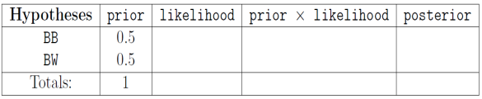
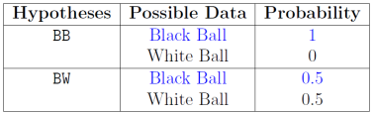
Bayesian Analysis
Perform the experiment. Take out one ball from the box.
D: The ball that was removed from the box was black.
Prior : Initial guess / probability
Likelihood: The likelihood for a hypothesis is the probability that you would have observed the data, if that hypothesis were true. The values can be found by going through each hypothesis in turn, imagining it is true, and asking,
“What is the probability of getting the data that I observed?".
This table demonstrates a method for calculating the likelihood values, by considering not just the data that actually occurred, but all data that might have occurred. Ultimately, it is only the probability of the data which actually occurred that matters, so this is highlighted in blue.

Slide 43
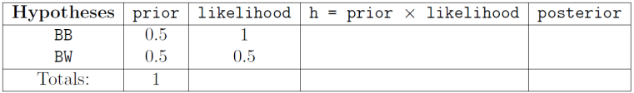
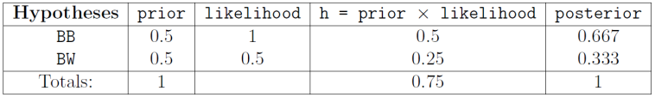
Bayesian Analysis
The third column of the Bayes' Box is the product of the prior probabilities and the
likelihoods, calculated by simple multiplication. The result will be called “prior times
likelihood", but occasionally we will use the letter h for these quantities. This is the
Un-normalised posterior. It does not sum to 1 as the posterior probabilities should, but it is at least proportional to the actual posterior probabilities.
To find the posterior probabilities, we take the prior likelihood column and divide
it by its sum, producing numbers that do sum to 1.
We can see that the posterior probabilities are not the same as the prior probabilities,
because we have more information now! The experimental result made BB a little bit more plausible than it was before. Its probability has increased from 1/2 to 2/3.

Slide 44
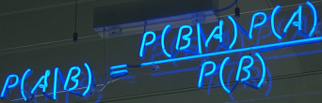

Bayesian Rule
Likelihood
Posterior probability/belief
Marginal likelihood.
Posterior probability
H : Hypothesis
D : Data
P(H|D) is the posterior probability. It describes how certain or confident we are that hypothesis H is true, given that we have observed data D.
P(H) is the prior probability, which describes how sure we were that H was true, before we observed the data D.
P(D|H) is the likelihood. If you were to assume that H is true, this is the probability that you would have observed data D.
P(D) is the marginal likelihood. This is the probability that you would have observed data D, whether H is true or not.

Slide 45
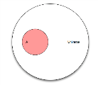
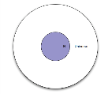
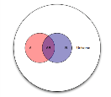
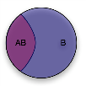

Bayes Theorem Intitule explanation
Say we are studying cancer, so we observe people and see whether they have cancer or not. If we take as our Universe all people participating in our study, then there are two possible outcomes for any particular individual, either he has cancer or not. We can split our universe in two events: the event “people with cancer” (designated as A), and “people with no cancer” (or ¬A). Then
the probability that a randomly chosen person has cancer?
That test will be “positive” for some people, and “negative” for some other people. If we take the event B to mean “people for which the test is positive”.
The probability that the test will be “positive” for a randomly selected person?
The probability that both the events occur simultaneously
Q : “given that the test is positive for a randomly selected individual, what is the probability that said individual has cancer?”. i.e. “given that we are in region B, what is the probability that we are in region AB?
What we’ve effectively done is change the Universe from U (all people), to B

Slide 46
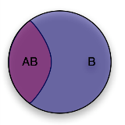
Bayes Theorem Intitule explanation
Q : “given that the test is positive for a randomly selected individual, what is the probability that said individual has cancer?”. i.e. “given that we are in region B, what is the probability that we are in region AB?
What we’ve effectively done is change the Universe from U (all people), to B
Lets ask the converse question “given that a randomly selected individual has cancer (event A), what is the probability that the test is positive for that individual (event AB)?”
which is to say P(AB) is the same whether you’re looking at it from the point of view of A or B, and finally
Bayes Theorem

Slide 47

Bayes Theorem For Cancer Testing
Let’s say that you are testing a generic patient for cancer.
One percent of the population has this cancer.
You have a test that will
return a True Positive (return a positive when they actually do have cancer) 99% of the time, and
return a True Negative (return a negative when they do not have cancer) 95% of the time.
You do 1 test, and get back a positive result. What are the odds this patient actually does have this cancer ?
1. Determine Possibilities
There are two possibilities. The patient either has cancer. Or they do not have cancer
2. Estimate Initial Probabilities
Since this is a generic patient they should be like the general population, so we assume there is a 1% chance they have cancer, and a 99% chance they do not.

Slide 48

Bayes Theorem For Cancer Testing
Conduct the test :
The result is a positive. If the patient has cancer, the probability of getting that result (True Positive) is 99%. If the patient does not have cancer, the probability of getting that result (False Positive) is 5% (which is 1 minus the 95% true negative rate)
The Combined Probability
We are just calculating what is the probability they have cancer, and got a positive test. And separately calculating what is the probability they do not have cancer, and got a positive test.

Slide 49

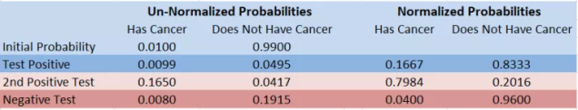
Bayes Theorem For Cancer Testing
Normalize The Results
At this step we see how likely the having cancer was, considering that a false positive was a possibility
And that is the answer, we have found that after the “99% Reliable” test, there is only a 16.7% chance that the patient has cancer
If you do additional tests, you use the new values as your starting probability. In this case let’s assume that we do a second test, get a Positive result, and then a third test and get a Negative Result.
After the second positive result, the odds the patient actually has cancer jumps up to 79.8%, but after the negative test, the odds drop back down to 4%

Slide 50
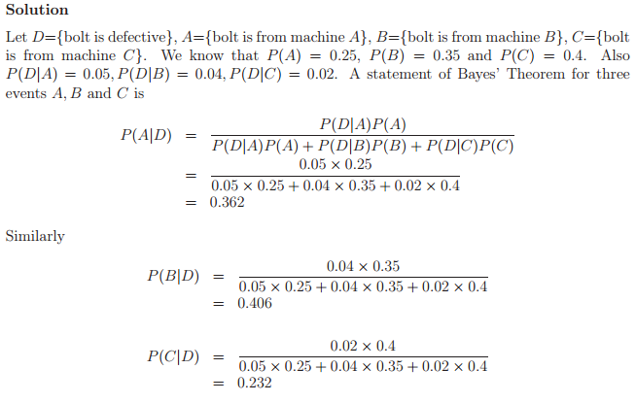
A factory production line is manufacturing bolts using three machines, A, B and C. Of the total output, machine A is responsible for 25%, machine B for 35% and machine C for the rest. It is known from previous experience with the machines that 5% of the output from machine A is defective, 4% from machine B and 2% from machine C.
A bolt is chosen at random from the production line and found to be defective. What is the probability that it came from
(a) machine A (b) machine B (c) machine C?

Slide 51
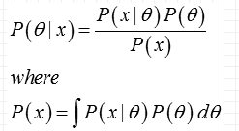
Bayes's Theorem for a single continuous random variable
The mathematics in above equation assumes that events A and B each have a single probability. While true in many cases, in most situations the events are better described with probability densities.
Let be the prior distribution of some parameter, .It is what is known about before the data, x, are collected. is the posterior distribution of and is what is known later, given the knowledge of the data.
Bayes's Theorem for a single continuous random variable is then:

